Slide 1
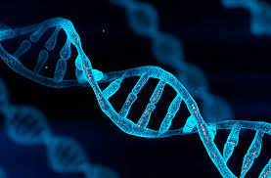
DNA STORAGE PROJECT pt 2
By Elad Gross and Yehonatan Lachman

Slide 2
What we set out to achieve
Given:
Read size L
N reads
Return original strand of length n.

Slide 3
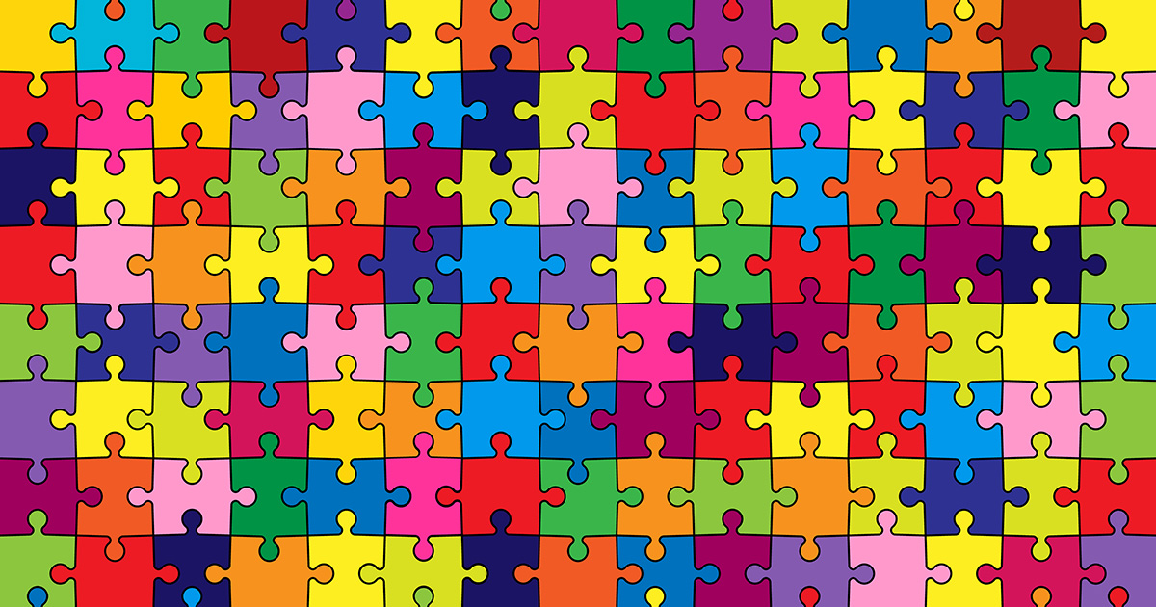
The original algorithm
Reads are pieces of puzzle
Linear average time complexity

Slide 4
The previous improvements
Repeated classifications
Padding
… | A | T | G | T | C | A | T | T | T | A | G | G | G | C | A | G | T | T
The classification of AC will tell us that this read is in section 1 for example
… | A | T | G | T | C | A | C | A | T | T | T | A | G | G | C | A | G | C | A | G | T | T | C | A
… | A | A | A | A | A | A | A | C | A | A | T | G | T | C | A | C | A | T | T | T | A | G | G | C | A | G | C | A | G | T | T | C | A

Slide 5
So, what’s left?
Excessive padding
Miss rate calculation

Slide 6
1. Padding is excessive
Padding of size L is overkill
Size of around O(log(n))
… | A | C | T | A | T | G | G | T | C | A | … | A | A | A | A | A | A | A | A | A | A | A | A | A | A | … | A | A | C | A | T | C | A
… | A | C | T | A | T | G | G | T | C | A | … | A | A | A | A | A | … | A | A | C | A | T | C | A
So why not change that and keep the rest of the algorithm?

Slide 7
The algorithm won’t work
If padding size is smaller than the size of the read,
The algorithm won’t declassify reads with padding
Have to create a new algorithm for declassifying
… | A | C | T | A | T | G | G | T | C | A | … | A | A | A | A | A | … | A | A | C | A | T | C | A
AC?
CT?

Slide 8
Change to the padding
In addition of decreasing the size, we’ll change the padding itself
The padding is a combination of the previous and following classifications
… | A | C | T | A | T | G | G | T | C | A | … | A | A | A | A | A | … | A | A | C | A | T | C | A
… | A | C | T | A | T | G | G | T | C | T | C | A | T | … | T | C | A | C | A | T | C | A

Slide 9
New algorithm steps
Like the previous algorithm, search for repetitive letters in the read
If found, return the candidate letters
Otherwise, there is padding either in the middle of the read or at one of its edges.
… | A | T | G | T | C | A | C | A | T | T | T | A | G | G | C | A | G | C
C | A

Slide 10
Find full padding
Store hashes of all possible paddings in advance
T | C | A | T | … | T | C | A
G | T | C | G | … | G | T | C

Slide 11
Find full padding
Store hashes of all possible paddings in advance
For each O(log(n)) letters in read, check hash equivalency with hash of paddings

Slide 12
Find full padding
Store hashes of all possible paddings in advance
For each O(log(n)) letters in read, check hash equivalency with hash of paddings
If the padding is found, we will split the read into two new reads and discard the old one (store each one in a different section)
… | A | C | T | A | T | G | G | T | C | T | C | A | T | … | T | C | A | C | A | T | C | A
T | C | A | … | T | C | A | T | C | A | T | C | A | T | … | T | C | A | C | A | T | C | A
… | A | C | T | A | T | G | G | T | C | T | C | A | T | … | T | C | A | T | … | T | C | A

Slide 13
Find full padding
Store hashes of all possible paddings in advance
For each O(log(n)) letters in read, check hash equivalency with hash of paddings
If the padding is found, we will split the read into two new reads and discard the old one
For each of the two new reads, we will save how much real data is in each section, both the one that comes before and the one that comes after
Save for each section the window with max data for the rest of the algorithm

Slide 14
Find partial padding
If the frequency is greater than the padding, then the code will not be executed.
Otherwise, we know the padding is either at the start or at the end
Take the first few letters from beginning of read
Generate a sub-read of size frequency from the letters
Compare to beginning of read. If not equal the padding is at end
Don’t forget cyclic change of candidates!

Slide 15
2. Miss rate
With a given miss rate, can we give an approximation of a minimum enlargement of the strand?

Slide 16
Our heuristic
Given a possible miss rate, we can go over all possible frequencies and letter amounts and check
Not optimized for big frequency ranges
However, big frequencies are very inaccurate so won’t be used often

Slide 17
Some results
TODO: need to check for different stuff before the meeting
Add images and whatnot

Slide 18
Conclusion
TODO: something?

